Slide 1

Automated Hyperspectral Pyrometry of Bulk Crystal Growths
Naman Parikh¹, Tyrel McQueen^{3,4,5,6}, David Elbert^{2,3}
¹Carnegie Mellon University, ²Institute for Data Intensive Engineering and Sciences, ³Hopkins Extreme Materials Institute, ⁴JHU Department of Materials Science and Engineering, ⁵JHU Department of Chemistry, ⁶Institute for Quantum Matter

Slide 2
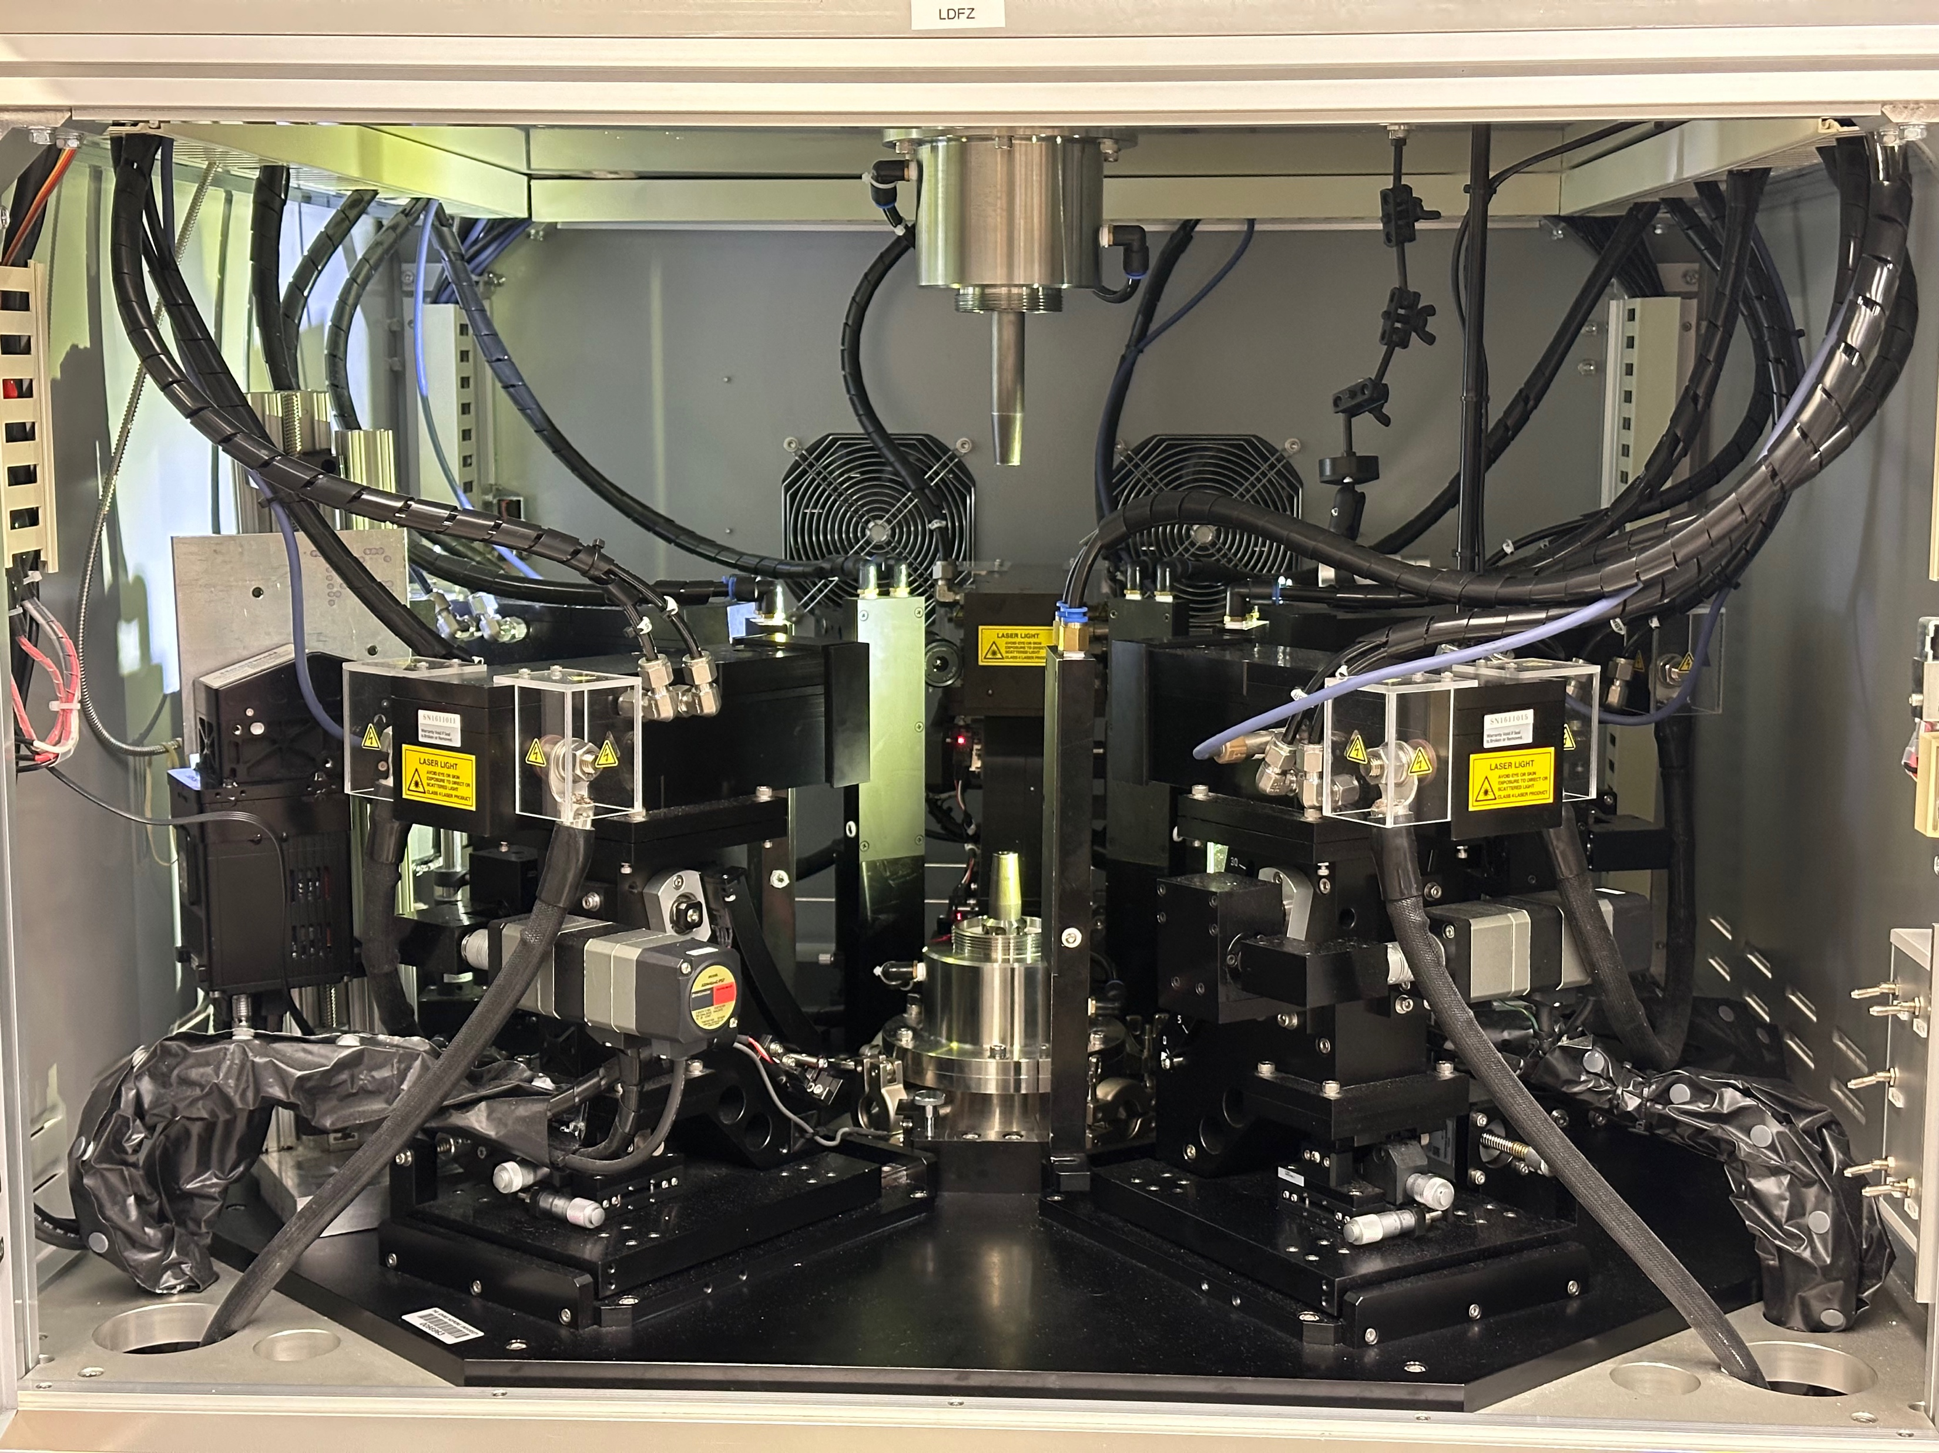
Laser Diode Floating Zone

Slide 3
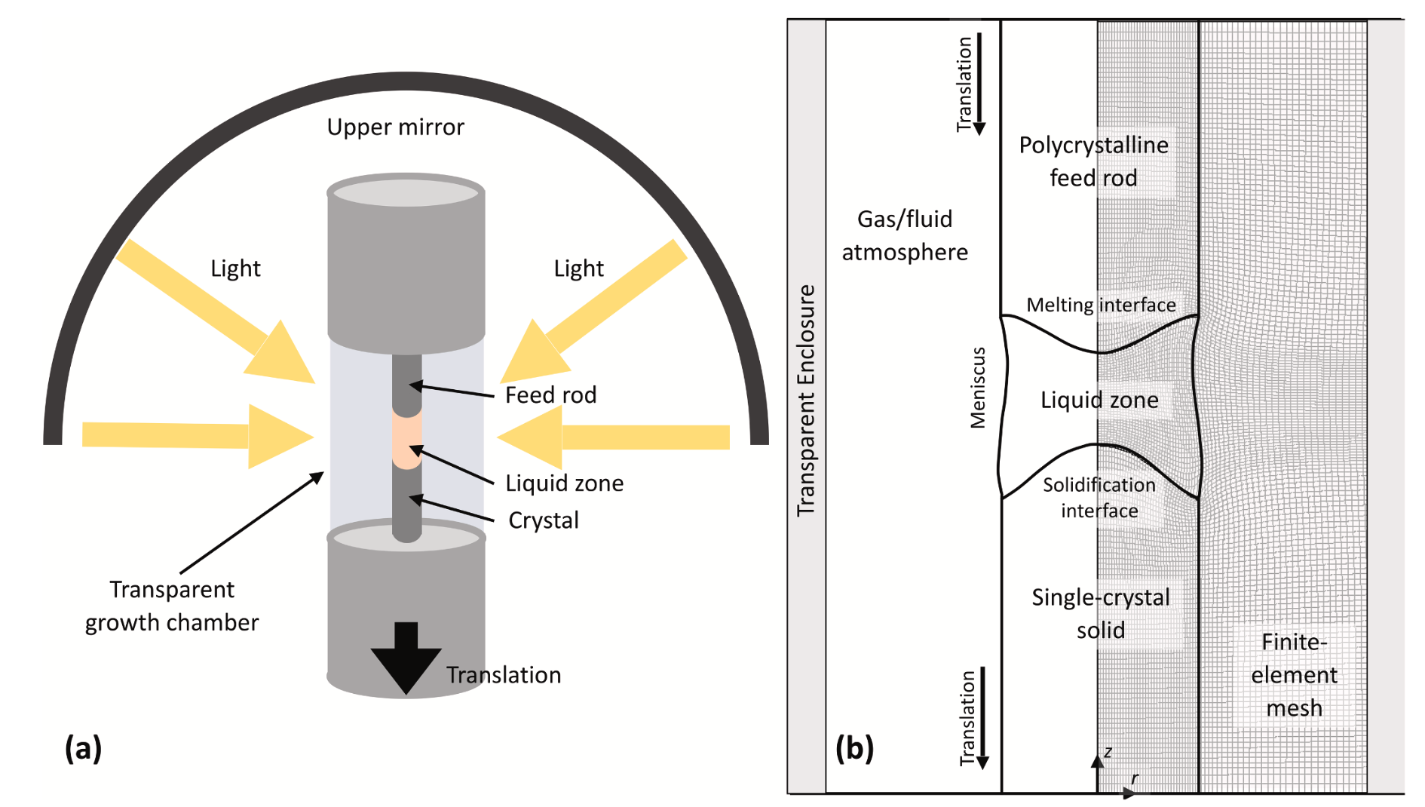
Scott S. Dossa, Jeffrey J. Derby
https://doi.org/10.1016/j.jcrysgro.2022.126723

Slide 4

Digital Twins

Slide 5
Digital Twins
A digital twin is a virtual representation of an object or system designed to reflect a physical object accurately.
-IBM
Notes:
Why do we want to make digital twins?

Slide 6
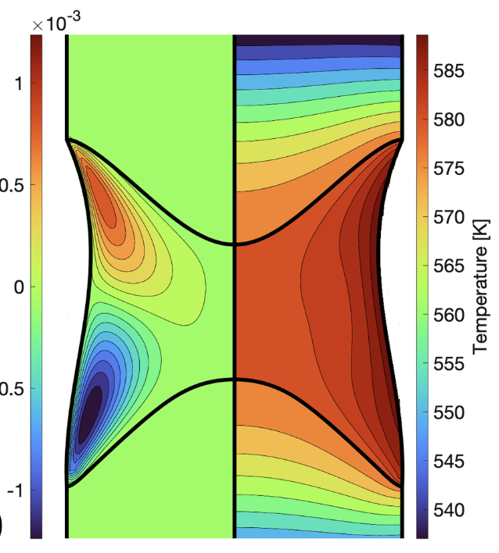
Modeling – NaNO₃
Scott S. Dossa, Jeffrey J. Derby
https://doi.org/10.1016/j.jcrysgro.2022.126723
6
Notes:
Talk about what is missing from this modeling – to make a digital twin we need actual experimental data to validate it
This takes temperatures as an input, so it’s like starting in the middle of a growth with know temperature field rather that from the beginning of the growth
Since temperature distribution is an input, IF I WANT TO USE THE MODEL FOR MY GROWTH, I need some way to measure the temperature distribution so I can then input it into the model – I need a way to collect this data
I also need a way to collect temperature distribution data to validate this model
Temperature is a critical parameter that is missing from these models

Slide 7
Research Question
How can we collect temperature data from lab growths?

Slide 8
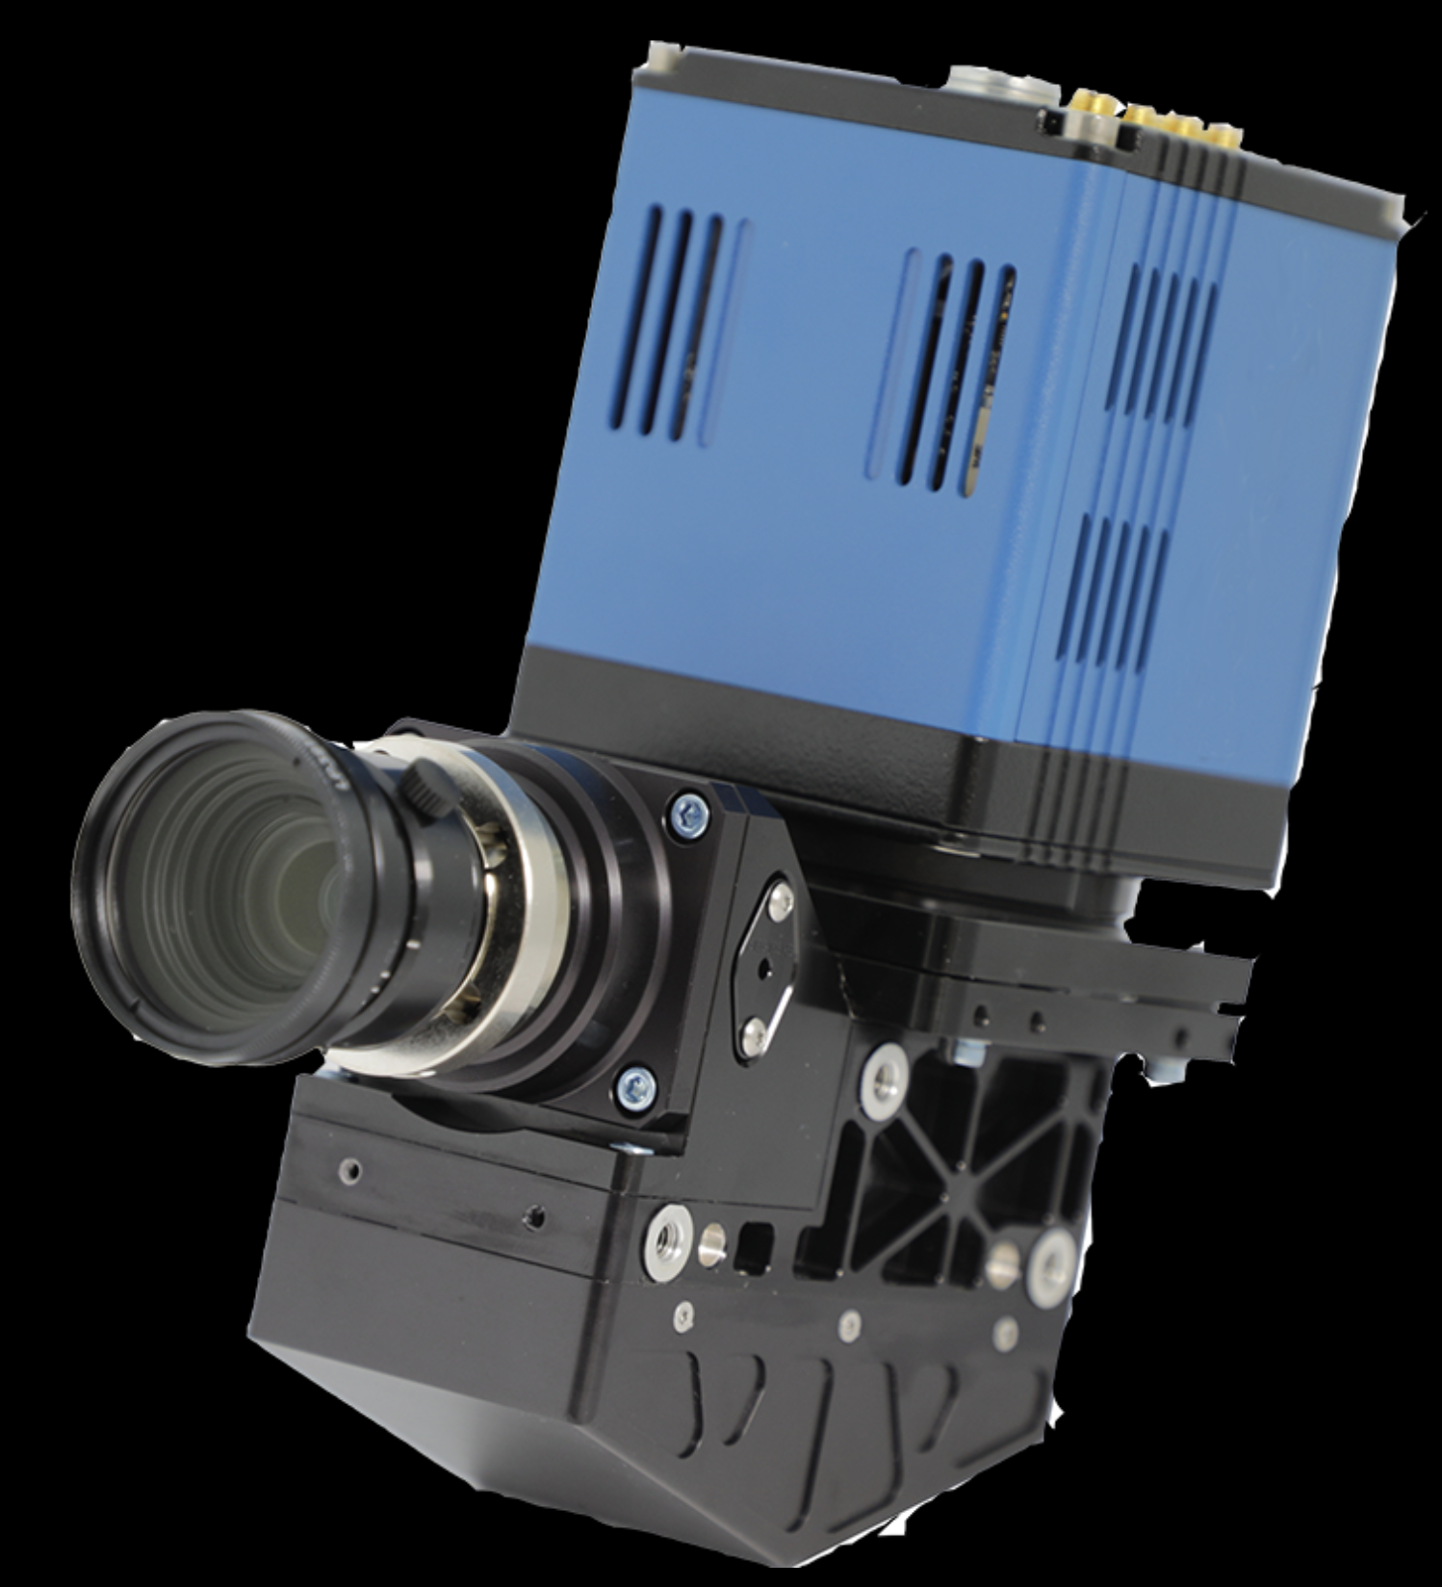
Hyperspectral Camera
Notes:
This is a hyperspectral camera. Ours is unfortunately not blue but that’s ok. It is a camera that measures hyperspectral data, which means intensity values at hundreds of wavelengths. This allows us to image an entire spectrum for each pixel.

Slide 9
What are the steps?
Notes:
What infrastructure do we need to get this data and use it to inform our digital twin

Slide 10
What are the steps?
Collect data
Notes:
Obviously

Slide 12
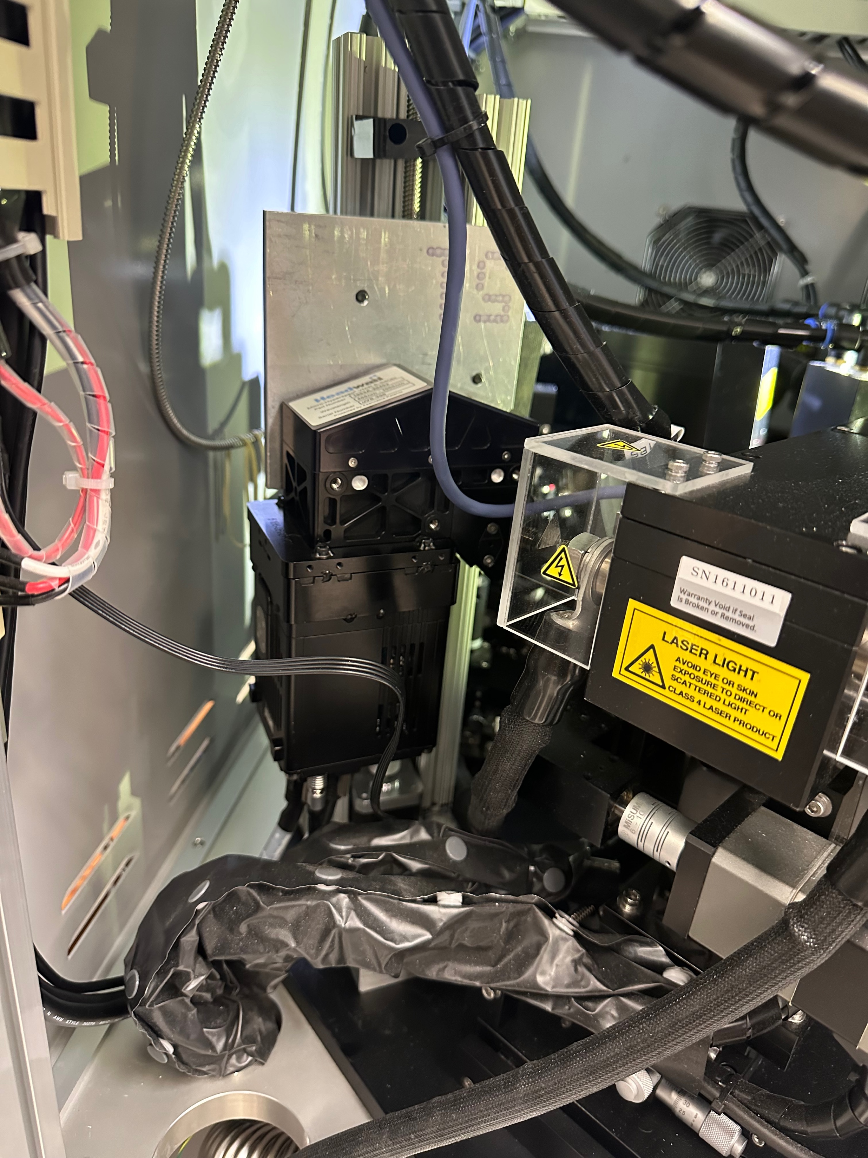

Slide 13
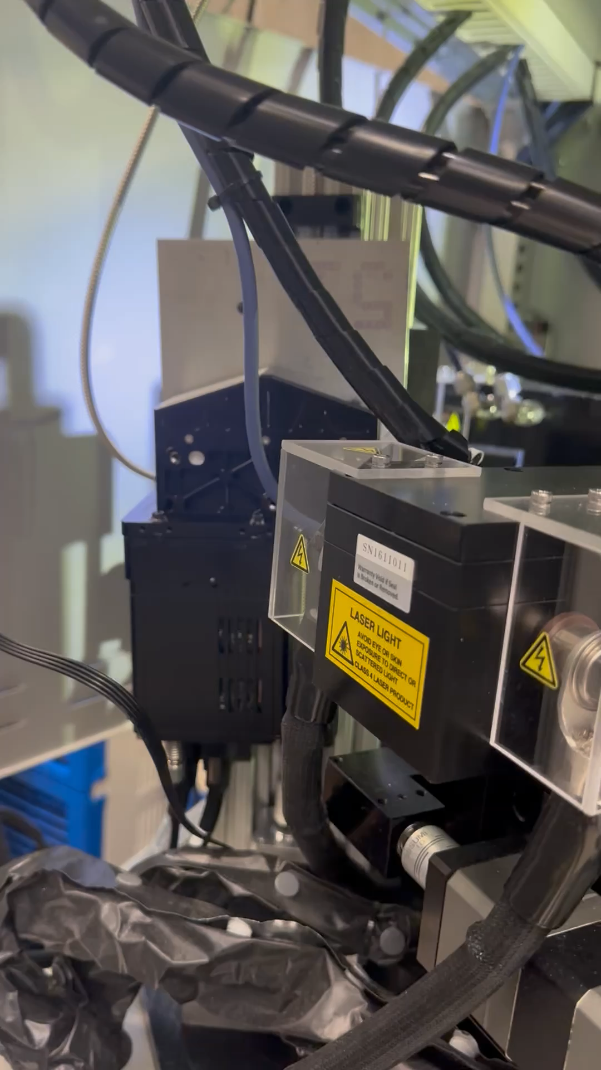

Slide 14
What are the steps?
Collect data
Analyze the data
Notes:
We need some way to determine the temperature from the hyperspectral data, which will take some physics and machine learning to do

Slide 15
What are the steps?
Collect data
Analyze the data automatically
Notes:
We want to ultimately collect a lot of data and collect it regularly, so we would like to automate this process to make it faster and easier. If we had robots that automatically took a sample out of the furnace, put it through an XRD analysis, and spit out the ready-to-analyze results, things would be much faster. This is the same idea; we have the computers automatically grab images as they come, analyze them, and spit out the result that we want to look at

Slide 16

Acknowledgements
Evan Crites (McQueen Lab, PARADIM)
Maggie Eminizer (IDIES)
NSF Awards #2039380 (PARADIM) and #2129051 (VariMat)
16

